Slide 1

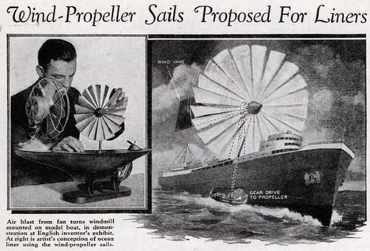
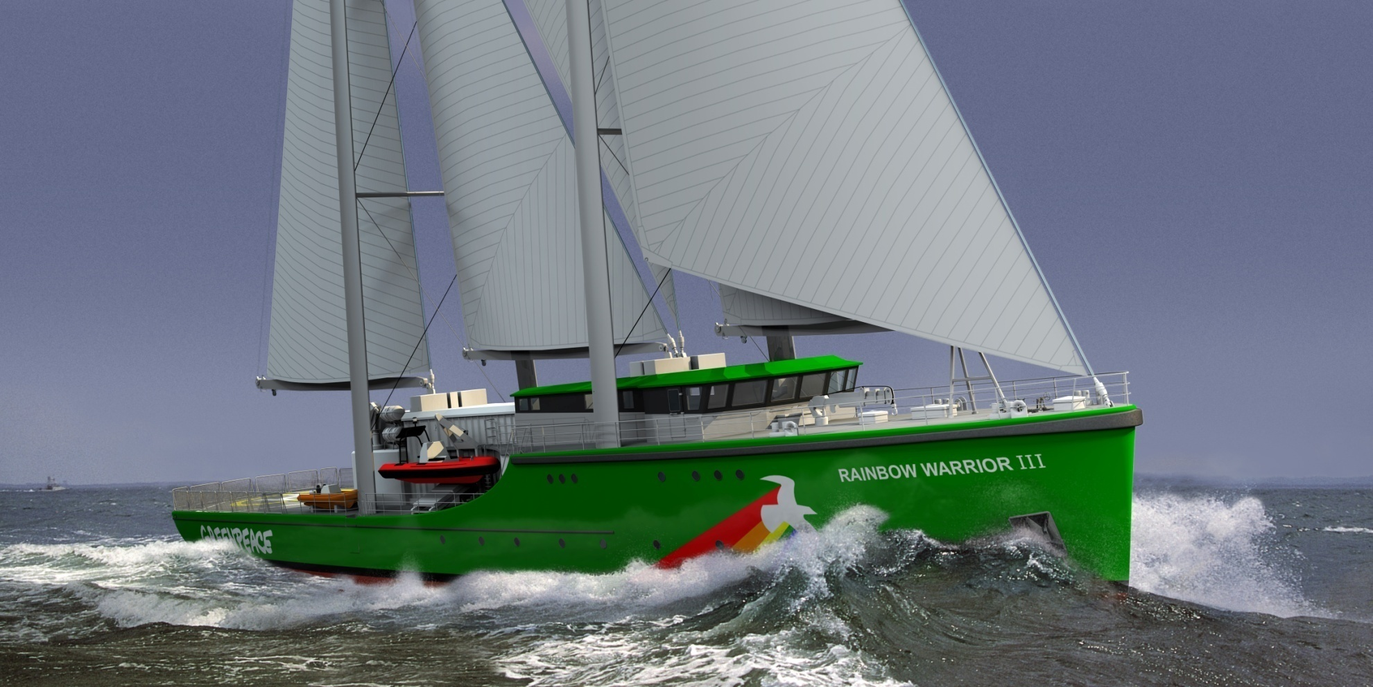
NSR Interreg project S@IL:
Sustainable Approaches & Innovative Liaisons
Lead Beneficiary: Province/County of Fryslan, Netherlands.
From March 2012 till June 2015.
Budget: 3.600.000 Euro

Slide 2
NSR Interreg project S@IL:
Partners involved:
Participating countries and partners:
Germany
Sweden
United Kingdom
France
Belgium
Netherlands
Denmark

Slide 3
NSR Interreg project S@IL:
Back ground
Aims
Objectives
Work packages
Methods, approach
Partners

Slide 4
1. Back ground:
  Lisbon and Goteborg agenda’s.
    Meeting the Energy Efficiency Design Index, www.imo.org .
    (sustainable and energy reduction is not the same)
  New (business) opportunities in hybrid sailing thanks to new technical developments in hardware and software.
  New opportunities for H.S. thanks to raised awareness by consumers and producers about sustainability. Sustainability is more and more experiences as a need in stead of a luxury.
  Hybrid sailing entrepreneurs with ready to market solutions.
  Fragmented knowledge, policy and expertise about hybrid sailing amongst public, private players, entrepreneurs.

Slide 5
2. AIMS:
Joint North Sea and NWE Region stimulating and facilitating the transition process toward a sustainable shipping sector with focus on zero emission freight sailing.
Development and promotion of competitive sustainable hybrid sailing concepts, including the execution of living lab pilots.
Building of public private alliances and developing of a Strategic Sustainable Sea Transport Plan in order to stimulate and coordinate the implementation of these findings.
Market conditions, policy aspects, supporting of actions like clean shipping labelling and public awareness are main items to complete this process

Slide 6
3. Objectives
Capacity building in competitive economic AND sustainable hybrid sailing concepts.
Development and testing of living lab solutions and modelling tools in view of sustainable hybrid sailing concepts.
Steps to embed sustainable hybrid freight sailing in policy and legislation.
Developing a Strategic Sustainable Sea Transport Plan containing scenario planning tools with Roadmaps till 2050, bearing zero emission sailing in mind.
Communication and promotion of S@il results to society

Slide 7
4: Work packages
Work package 1:
  Project management
Work package 2:
  Publicity and communication
  Work package 3:
    Applied technical engineering, design, create living labs.
  Work package 4:
    Economy and investments opportunities
  Work package 5:
    Policy and legislation in relation to hybrid sailing
  Work package 6:
    Building public-private alliances

Slide 8
4: Work packages
Work package 1: Project management
Work package 2: Publicity and communication
  Bringing the message about hybrid sailing, connect with hinterlands, co-creative development, organizing events.
  Work package 3: Applied technical engineering, design, create living labs.
    Evaluation of new and existing sustainable hybrid propulsion systems.
    Development multiple design logistic packages optimized for regional settings, specific routes, shipping lanes.
    Identify wind potentials for hybrid sailing ships. For past/future climate conditions. Evaluation wind velocities, directions. Develop voyage planning weather routing based on weather forecast and ocean GRIB data commercial sailing ships.

Slide 9
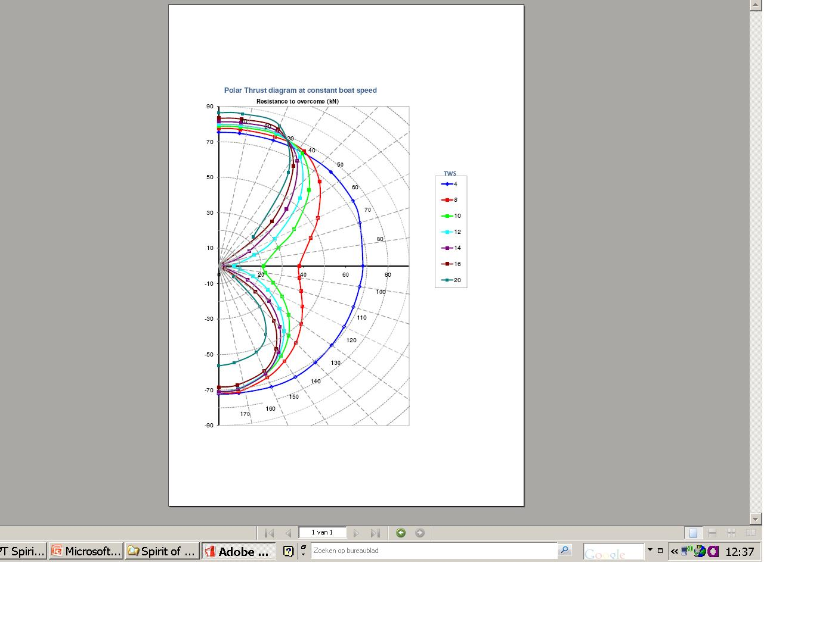
4: Work packages
Work package 1: Project management
Work package 2: Publicity and communication
  Bringing the message about hybrid sailing, connect with hinterlands, co-creative development, organizing events.
  Work package 3: Applied technical engineering, design, create living labs.
    Evaluation of new and existing sustainable hybrid propulsion systems.
    Development multiple design logistic packages optimized for regional settings, specific routes, shipping lanes.
    Identify wind potentials for hybrid sailing ships. For past/future climate conditions. Evaluation wind velocities, directions. Develop voyage planning weather routing based on weather forecast and ocean GRIB data commercial sailing ships.

Slide 10
4: Work packages
  Work package 3:
  Applied technical engineering, design, create living labs
  Development of at least three hybrid sailing ship concepts; optimized for specific routes; taking into account wind conditions, sizes of ships and local settings.
  Compare efficiency and handling of hybrid sailing ships. Develop hybrid sailing ship efficiency indicators.
  Improvement of existing and new CONCEPTUAL DESIGNS of hulls, riggings, draught, loading for sailing ships in also in relation to stability criteria.
  Execution and evaluation of pilot projects based on multisustainable propulsion systems. Rigid wings, LNG, Sailing Ships, 3 hybrid fishing ship etc.

Slide 11
4: Work packages
  Work package 4: Hybrid freight sailing in relation to economy.
    Feasibility research, scenario development, develop Strategic Sustainable Sea Transport Plan containing scenario planning tools with roadmap till 2050.
    Financial modelling; different hybrid sailing ship concepts in different contexts, investment cycles contributing to scenario planning. Identify investment models, (e.g. community funding) and promote them when contacting investors.
    Impacts of logistics, define appropriate shipping lanes for different hybrid sailing ship concepts related to economic- and sustainable return of investments.
    Marketing, identify target groups, unique selling points of hybrid sailing, branding message. Engage with cargo owners, owners, forwarders, brokers, ship owners, attend international events related to shipping. Interact with IMO, Green shipping coalition, Danish shipowner association, MAERSK Line etc.

Slide 12
4: Work packages
  Work package 5:
  Influence integrate policy legislation related to hybrid freight sailing.
  Review policy and develop recommendations in relation to building and operating hybrid sailing ships. Interact with decision makers IMO, EU, NS riparian states.
  Fit environmental ship indices in hybrid freight sailing.
    Harmonisation ship indices in different harbours.
    Define incentives that facilitate the implementation of Hybrid Sailing.
    Promote eco-labelling schemes (proactive governance)
    Low carbon shipping incentives.
    Steps to include hybrid freight sailing in ETS: Emission Trading System.
    Make recommendations for legislation based on earlier calculations.
  Environmental issues and their impact. Research for environmental benefits of hybrid freight sailing. Calculate emission reduction, for several scenario’s based on different hybrid sailing concepts. Run advances 3 dimensional chemistry transport model for calculating reduced pollutants concentrations in the NSR. Estimate benefits environment, public health societal benefits.

Slide 13
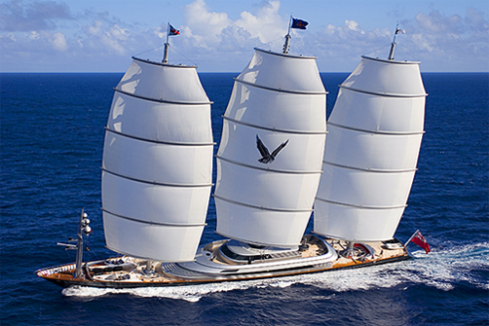
4: Work packages
  Work package 6:
  Building public private alliances aiming for implementation
  Enhance good proactive governance and sustainable s@il)business also by including public awareness. Enhance active Corporate Social Responsibility policy.
  Building of co-creative alliances; by involving regional hinterland stakeholders during the development of s@iling concepts. Involve different kind of partners, including end users in regional S@IL activities.
  Clustering and building private public alliances. From contact to contract events. Develop new network models.

Slide 14
5: Methods / approach
Partnership:
  Complementarity
  Twinning
  Cross sectoral, public and private partners, end users, producers and consumers.
  Horizontal linkages with counterparts in different NSR, NWE regions.
  Vertical linkages Public Private; eg Brussels harmonise low carbon shipping incentives.
Approach:
  Triple Helix approach:
    Economy,
    Science and
    Policy.
  End users involvement, who are they and how to get them in the project to realize a co-creative (co-creation) process. Generation and on going realization of mutual firm-customer value.
  Transnational learning by organising transnational workshops, webinars, conferences, face to face and digital, linked in groups etc.
  Building business alliances/liaisons, from contact to contract, events, flyers, promotion and publicity.

Slide 15
5: Methods / approach
Organisation:

Slide 16
5: Methods / approach

Slide 17
5: Methods / approach

Slide 18
5: Methods / approach

Slide 19




6: Partners
Province of Fryslan: Lead Beneficiary
Marinvest
Plymouth University
Jade Hoch Schule
Helmholtz-Zentrum Geesthacht
Aalborg University

Slide 20
6: Partners
North Sea Foundation
Fair Transport
Municipality/port Harlingen
C-Job
Ameland Shipping
Northern University Applied science

Slide 21
6: Partners
MARIN
E&E consultants
Avel Vor Technologie
Port of Oostende
Eco Council

